Slide 1

Computer Programmer: FPS Inventory

Slide 2



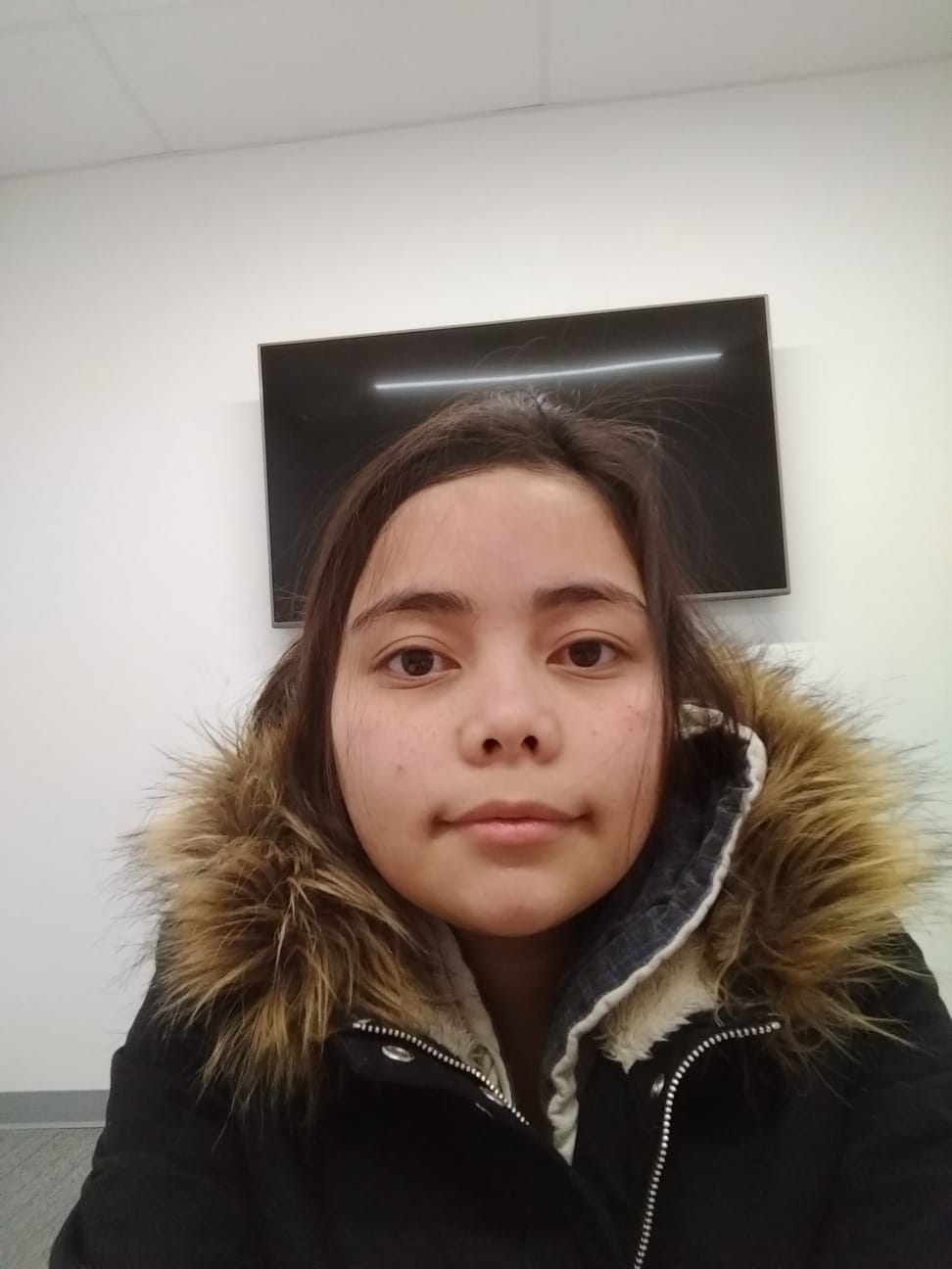
Mentored by: Sonam Devgan
Sandy MacAskill
Felipe Mafra
Dos Santos
Jemillee Prado

Slide 3
Organize and Update your inventory system today!
Find products quickly and easily
Keep customers happy and informed
Cut down on time waste at multiple locations

Slide 4
Featuring: SQL Server ASP.Net HTML5, CSS3, Javascript and Jquery

Slide 5
What does it do?
Access your inventory from any web capable device
Import existing Excel inventory
Search for the right item at the right location
Browse entire departments
Generate a weekly re-order list
Transfer stock between locations

